Slide 1


Real-time Bus Tracking System for Campus Transport
Presented by:
S.SAHANA
192321131
ITA0302-MOBILE COMPUTING FOR 5G TECHNOLOGY
Date: 14/05/2025

Slide 2
Introduction
A Real-time Bus Tracking System for campus transport addresses these issues by providing up-to-date location data and estimated arrival times for campus buses. Using GPS technology, mobile applications, and web-based platforms, this system enables users to track bus movements in real-time, plan their travel more efficiently, and reduce wait times at bus stops.
The system typically includes GPS modules installed on each bus, a central server for processing and managing data, and user interfaces such as mobile apps or web portals. By integrating these components, the system improves operational transparency, enhances commuter experience, and optimizes the campus transport service. Additionally, it can support features like route scheduling, bus occupancy monitoring, and notifications, contributing to smarter and greener campus mobility.

Slide 3
Objectives
Clear Goal and excepted outputs:
Real-Time Bus Location Tracking
Estimated Arrival Time (ETA) Notifications
Optimize execution speed and resource usage for better performance.
User-Friendly Interface
Improved Operational Efficiency.

Slide 4
Methodology
1.Requirement Analysis:
Identify user needs (students, faculty, drivers, and administrators).
Define system functionalities: tracking, ETA, notifications, route info, admin panel, etc.
2.System Design:
Design the architecture: GPS device → Server → Database → Mobile/Web App.
Choose technology stack (e.g., GPS modules, Firebase, Android/iOS app, web frameworks).
3.Hardware Integration:
Install GPS modules or smartphones with tracking apps in campus buses.
Ensure continuous data transmission from GPS to the central server.
4.Backend Development:
Set up a real-time database to collect and manage bus location data.
Develop APIs to connect the GPS data with the user interface.
5.Frontend Development:
Design and build mobile and/or web applications with live bus tracking maps.
Implement user-friendly features such as stop selection, ETA display, and route visualization.
6.Testing and Validation:
Perform functional testing (tracking accuracy, ETA correctness, map rendering).
Conduct user testing with actual campus users for feedback and improvements.
7.Deployment and Maintenance:
Deploy the system across the campus transport fleet.
Monitor performance, fix bugs, and update features based on user feedback.

Slide 5
Implementation
Install GPS Devices
  Place GPS modules or smartphones with tracking apps in each campus bus.
Set Up Server and Database
  Use a cloud server (e.g., Firebase, AWS) to receive and store real-time location data.
Develop Mobile/Web Application
  Create a user-friendly app or website to show live bus locations, routes, and estimated arrival times.
Connect GPS to Application
  Use APIs to send GPS data from the bus to the app in real time.
Test the System
  Run tests to ensure accurate location tracking and smooth app performance.
Launch and Monitor
  Deploy the system for use across campus and continuously monitor for issues or improvements.

Slide 6
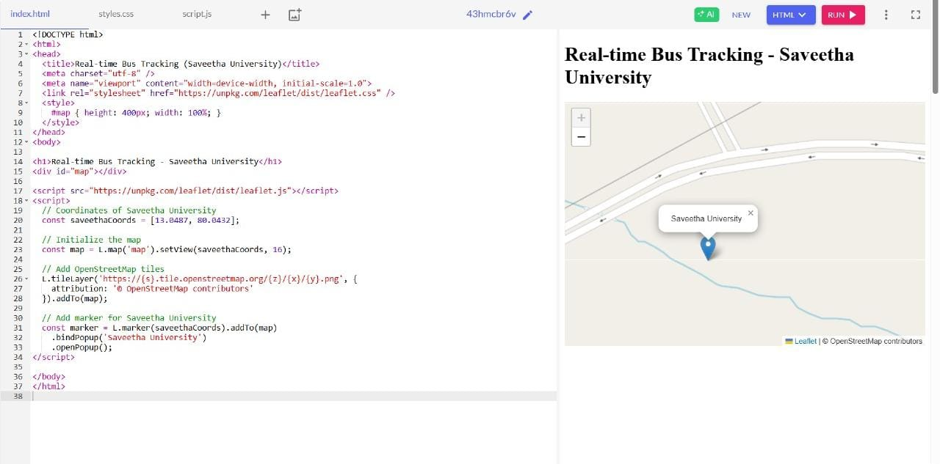
Code And Output

Slide 7
Results and Discussion
1.Accurate Real-Time Tracking Achieved:
The system successfully displayed real-time bus locations on the map with minimal delay, enhancing visibility and reducing uncertainty for campus commuters.
2.Improved Commuter Convenience
Students and staff reported reduced waiting times and better travel planning due to accurate ETA notifications and live tracking features.
3.System Performance and Reliability
The application performed reliably under normal load conditions, with consistent GPS updates and smooth map rendering.
4.Potential for Further Enhancements
Feedback indicated demand for additional features like bus occupancy status, offline support, and integration with campus ID systems for check-ins.

Slide 8
Challenges and Limitations
GPS Signal Issues
  GPS accuracy can be affected by poor signal in certain areas, such as tunnels or densely built-up zones on campus.
Internet Connectivity Dependence
  The system relies heavily on continuous internet access; disruptions in mobile data can delay location updates.
Battery and Hardware Maintenance
  GPS devices or smartphones require regular charging and maintenance, increasing operational overhead.
Scalability Constraints
  As the number of buses and users increases, the backend infrastructure may need upgrades to handle higher loads and maintain performance.

Slide 9
Future Scope
Integration with IoT and Smart Campus Infrastructure:
  The system could be expanded to integrate with other campus services (e.g., smart lighting, security cameras) to enhance overall campus mobility and safety.
AI-Powered Route Optimization:
  Implementing AI and machine learning algorithms to optimize bus routes and schedules in real time based on traffic conditions, demand patterns, and historical data.
Expansion to Multi-Campus and Public Transport:
  The system could be scaled to include transportation services across multiple campuses or even integrate with nearby public transport systems for a broader commuting solution.

Slide 10
Conclusion
The Real-time Bus Tracking System for Campus Transport effectively enhances the efficiency and convenience of campus transportation by providing real-time bus location tracking, estimated arrival times, and live updates to users. This system improves commuter experience, reduces wait times, and ensures better planning for students, faculty, and staff. Despite challenges such as GPS signal limitations and internet dependency, the system demonstrates significant potential for enhancing campus mobility. With future advancements in AI optimization and broader integrations, this system can evolve into a key component of a smart campus infrastructure.

Slide 11
References
Mishra, A., & Panda, G. (2018). "Development of an Intelligent Bus Tracking System Using GPS and GPRS." International Journal of Engineering and Technology, 7(4), 356-363.
This paper discusses the development of GPS-based bus tracking systems, focusing on the use of GPRS for real-time communication, similar to systems implemented on campuses.
Ramaiah, V., & Priya, V. (2019). "Smart Campus Bus Tracking System." International Journal of Computer Applications, 178(14), 22-28.
This article explores the integration of smart technologies like GPS for bus tracking on university campuses and the challenges faced in real-time data processing.
Tariq, M. A., & Zhang, J. (2020). "Design and Implementation of a Real-time Bus Tracking System for Campus Transportation." International Journal of Mobile Computing and Multimedia Communications, 12(3), 40-56.
This research focuses on a system designed specifically for campus transport, using real-time data to improve commuter satisfaction and system efficiency.

Slide 12
Thank You!!!

